Slide 1
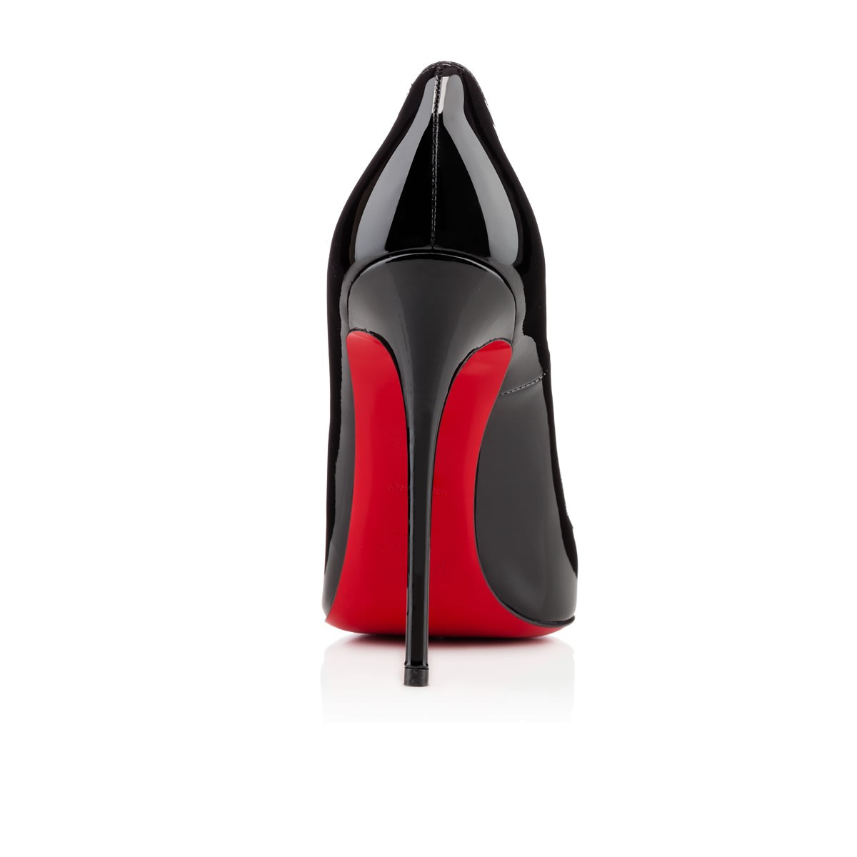
COFER’S WEEK AT A GLANCE
Week of 8/15
FMR and ADV. FMR (Draft)

Slide 2
MKT-FMRE-1 Demonstrate employability skills required by business and industry. 1.1 Communicate effectively through writing, speaking, listening, reading, and interpersonal abilities.
Monday’s Agenda
Learning Target: I can communicate effectively through writing, speaking, listening, reading and interpersonal abilities.
Opening (10-15) Opening Video on self image.
Work Session (20-25) Self Image discussion/Activity on Self-Image
Closing: Exit listening to self-image selections

Slide 3
MKT-FMRE-1 Demonstrate employability skills required by business and industry. 1.1 Communicate effectively through writing, speaking, listening, reading, and interpersonal abilities.
Tuesday’s Agenda
Learning Target: I can communicate effectively through writing, speaking, listening, reading and interpersonal abilities.
Opening (10-15) Current Event
Work Session (20-25) Personal Style-defined
Closing: Review for tomorrow’s topic

Slide 4
MKT-FMRE-1 Demonstrate employability skills required by business and industry. 1.1 Communicate effectively through writing, speaking, listening, reading, and interpersonal abilities.
Watch it Wednesday’s Agenda
Learning Target: I can communicate effectively through writing, speaking, listening, reading and interpersonal abilities.
Opening (10-15) Explanation of Watch It Wednesday
Work Session (20-25) Sneaker Shopping video or Discussion
Closing: Student feedback on videos before exiting

Slide 5
MKT-FMRE-1 Demonstrate employability skills required by business and industry. 1.1 Communicate effectively through writing, speaking, listening, reading, and interpersonal abilities.
Thursday’s Agenda
Learning Target: I can communicate effectively through writing, speaking, listening, reading and interpersonal abilities.
Opening (10-15) Fashion Video and discussion
Work Session (20-25) Activity on Customer Service/Personal Style
Closing: Review for tomorrow’s topic

Slide 6
MKT-FMRE-1 Demonstrate employability skills required by business and industry. 1.1 Communicate effectively through writing, speaking, listening, reading, and interpersonal abilities.
Friday’s Agenda
Learning Target: I can communicate effectively through writing, speaking, listening, reading and interpersonal abilities.
Opening (10-15) Explanation and Expectations of Fashion Friday and DECA Friday, Expectations for Ice Breakers
Work Session (20-25) 2ND DECA Membership Briefing, Ice Breaker
Closing: Fill out DECA interest form before leaving.

Slide 7
Additional Standards
1.1 Communicate effectively through writing, speaking, listening, reading, and interpersonal abilities.
1.3 Exhibit critical thinking and problem solving skills to locate, analyze and apply information in career planning and employment situations.
1.4 Model work readiness traits required for success in the workplace including integrity, honesty, accountability, punctuality, time management, and respect for diversity.
1.6 Present a professional image through appearance, behavior and language

Slide 8
Resources
www.youtube.com
GLENCO Marketing Book
Vogue Magazine
www.amazon.com
GMEA
FMR RCSS Curriculum Map
www.gadoe.org
Nocti Pathway Study Guides

Slide 9
Criteria For Success
Can I identify what I need to complete my pathway?
What are the qualifications to become a pathway completer?
How does DECA relate to the Marketing classes
What are the expectations for student-led current event discussions during the opening?
Minor grades and Major grades

